Slide 1
Software Life Cycle
Software process Models: Classical waterfall model, iterative waterfall model, prototyping model, evolutionary model, spiral model, RAD model. Essential Idea behind Agile Models, Agile models: Extreme programming and Scrum, Agile versus Other Models

Slide 2
Software Life Cycle
A software life cycle model (also called process model) is a descriptive and diagrammatic representation of the software life cycle.
Represents all the activities required to make a software product transit through its life cycle phases.
Captures the order in which these activities are to be undertaken.
In other words maps the different activities performed on a software product from its inception to retirement.

Slide 3
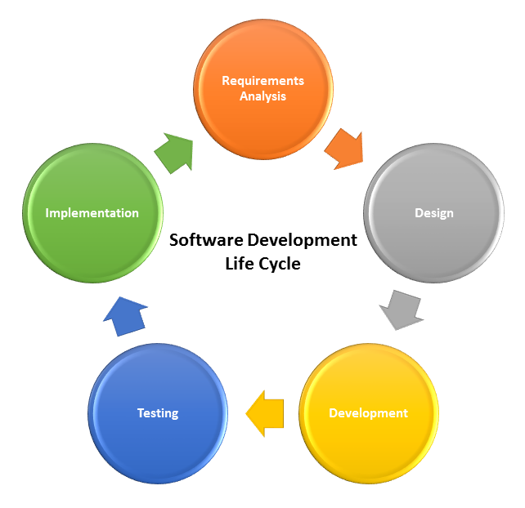
Activities - example

Slide 4
Different life cycle models may map the basic development activities to phases in different ways.
Thus, no matter which life cycle model is followed, the basic activities are included in all life cycle models though the activities may be carried out in different orders in different life cycle models.
During any life cycle phase, more than one activity may also be carried out.
For example, the design phase might consist of the structured analysis activity followed by the structured design activity.

Slide 5
Need for a software life cycle model
Development team must identify a suitable life cycle model for the particular project and then adhere to it.
Without using of a particular life cycle model the development of a software product would not be in a systematic and disciplined manner.
When a software product is being developed by a team there must be a clear understanding among team members about when and what to do.
Otherwise it would lead to chaos and project failure.

Slide 6
Suppose a software development problem is divided into several parts and assigned to the team members.
From then on, suppose the team members are allowed the freedom to develop the parts assigned to them in whatever way they like.
It is possible that one member might start writing the code for his part,
Another might decide to prepare the test documents first,
And some other engineer might begin with the design phase of the parts assigned to him.
This would be one of the perfect recipes for project failure.

Slide 7
A software life cycle model defines entry and exit criteria for every phase.
A phase can start only if its phase-entry criteria have been satisfied.
So without software life cycle model the entry and exit criteria for a phase cannot be recognized.
Without software life cycle models it becomes difficult for software project managers to monitor the progress of the project.

Slide 8
Different software life cycle models
Many life cycle models have been proposed so far.
Each of them has some advantages as well as some disadvantages.
Classical Waterfall Model
Iterative Waterfall Model
Prototyping Model
Evolutionary Model
Spiral Model

Slide 9
Identify the problem one would face, if he tries to develop a large software product without using software engineering principles.
Identify the two important techniques that software engineering uses to tackle the problem of exponential growth of problem complexity with its size.
State five symptoms of the present software crisis.
Identify at least four basic characteristics that differentiate a simple program from a software product.
Identify at least two advantages of using high-level languages over assembly languages.
State at least five advantages of object-oriented design techniques.
State at least three differences between the exploratory style and
modern styles of software development.

Slide 10
Model-1
Classical Waterfall Model

Slide 11
Classical Waterfall Model
Classical waterfall model divides life cycle into phases:
feasibility study,
requirements analysis and specification,
design,
coding and unit testing,
integration and system testing,
maintenance.

Slide 12
Classical Waterfall Model
Feasibility Study
Req Analysis
Design
Code
Test
Maintenance

Slide 13
Relative Effort for Phases
Phases between feasibility study and testing
known as development phases.
Among all life cycle phases
maintenance phase consumes maximum effort.
Among development phases,
testing phase consumes the maximum effort.

Slide 14
Classical Waterfall Model (CONT.)
Most organizations usually define:
standards on the outputs (deliverables) produced at the end of every phase
entry and exit criteria for every phase.
They also prescribe specific methodologies for:
specification,
design,
testing,
project management, etc.

Slide 15
a) Feasibility Study
Main aim of feasibility study: determine whether developing the product
financially worthwhile
technically feasible.
First roughly understand what the customer wants by:
Data : study different input data to the system and output data to be produced by the system
Process :what kind of processing is needed to be done on these data and they look at the various constraints on the behaviour of the system.
After an overall understanding of the problem they investigate the different solutions that are possible.
Examine each of the solutions in terms of resources required, cost of development and development time for each solution.
Notes:
At first project managers or team leaders try to have a rough
understanding of what is required to be done by visiting the client
side. They study different input data to the system and output data
to be produced by the system. They study what kind of processing
is needed to be done on these data and they look at the various
constraints on the behavior of the system.
􀂃 After they have an overall understanding of the problem they
investigate the different solutions that are possible. Then they
examine each of the solutions in terms of what kind of resources
required, what would be the cost of development and what would
be the development time for each solution.
􀂃 Based on this analysis they pick the best solution and determine
whether the solution is feasible financially and technically. They
check whether the customer budget would meet the cost of the

Slide 16
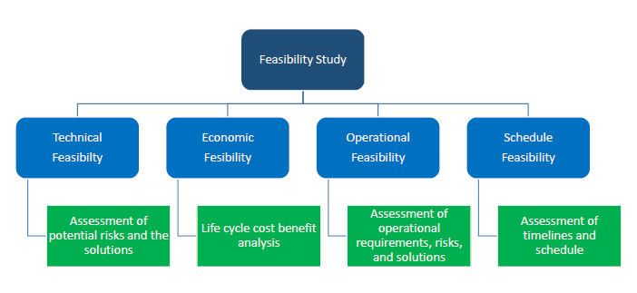
Feasibility Study

Slide 17
Activities during Feasibility Study
Perform a cost/benefit analysis:
Based on this analysis pick the best solution and determine whether the solution is feasible financially and technically.
Check whether the customer budget would meet the cost of the product and whether they have sufficient technical expertise in the area of development.

Slide 18
b) Requirements Analysis and Specification
Aim of this phase:
understand the exact requirements of the customer,
document them properly.
Consists of two distinct activities:
requirements gathering and analysis
requirements specification.

Slide 19
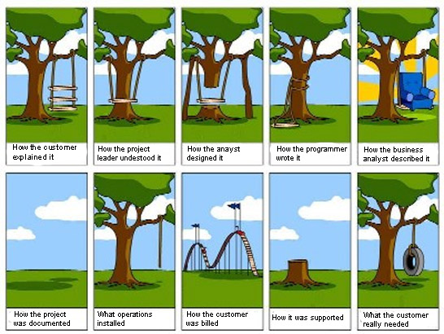

Slide 20
Goals of Requirements Analysis
Collect all related data from the customer:
analyze the collected data to clearly understand what the customer wants,
find out any inconsistencies and incompleteness in the requirements,
resolve all inconsistencies and incompleteness.

Slide 21
Requirements Gathering Process
One-on-One Interviews : These can be users who interact with the current or new system, management, project financers or anyone else that would be involved in the system. Contain open and close ended questions.
Group Interviews : Important to note which issues are generally agreed upon, and which issues differ.
Questionnaires/Surveys : This is especially helpful when stakeholders are spread out geographically
User Observation: For optimal results, the consultant should schedule three different periods of observation: low, normal, and peak times. This may prove helpful in because the user may interact with the system differently during different times.
Analyzing Existing Documents: Reviewing the current process and documentation can help the analyst understand the business, or system, and its current situation.
Joint Application Design/JAD

Slide 22
For example, for a business accounting software:
interview all the accountants of the organization to find out their requirements.

Slide 23
Requirements Analysis (CONT.)
The data you initially collect from the users:
would usually contain several contradictions and ambiguities:
each user typically has only a partial and incomplete view of the system.

Slide 24
Requirements Analysis (CONT.)
Ambiguities and contradictions:
must be identified
resolved by discussions with the customers.
Next, requirements are organized:
into a Software Requirements Specification (SRS) document.

Slide 25
Requirements Analysis (CONT.)
Engineers doing requirements analysis and specification:
are designated as analysts.

Slide 26
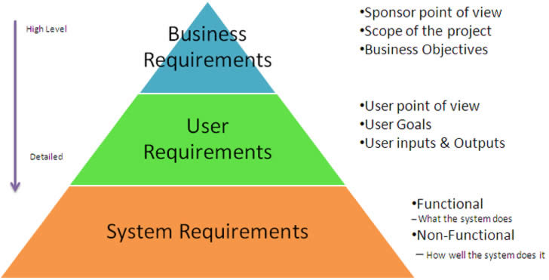
Requirements types

Slide 27
c) Design
Design phase transforms requirements specification:
into a form suitable for implementation in some programming language.

Slide 28
Design
In technical terms:
during design phase, software architecture is derived from the SRS document.
Two design approaches:
a) traditional approach,
b) object oriented approach.

Slide 29
a) Traditional approach – Design Phase
Consists of two activities:
Structured analysis
Structured design
1. Structured Analysis Activity
Identify all the functions to be performed.
Identify data flow among the functions.
Decompose each function recursively into sub-functions.
Identify data flow among the subfunctions as well.
Carried out using Data flow diagrams (DFDs).

Slide 30
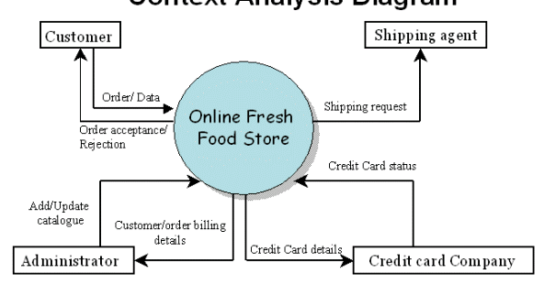
Data flow diagram example

Slide 31
Traditional approach – Design Phase
2. Structured Design
After structured analysis, carry out structured design:
architectural design (or high-level design)
detailed design (or low-level design).
High-level design:
decompose the system into modules,
represent invocation relationships among the modules.
Detailed design:
different modules designed in greater detail:
data structures and algorithms for each module are designed.

Slide 32
b) Object Oriented Design
First identify various objects (real world entities) occurring in the problem:
identify the relationships among the objects.
For example, the objects in a pay-roll software may be:
employees,
managers,
pay-roll register,
Departments, etc.
Object structure
further refined to obtain the detailed design.
OOD has several advantages:
lower development effort,
lower development time,
better maintainability.

Slide 33
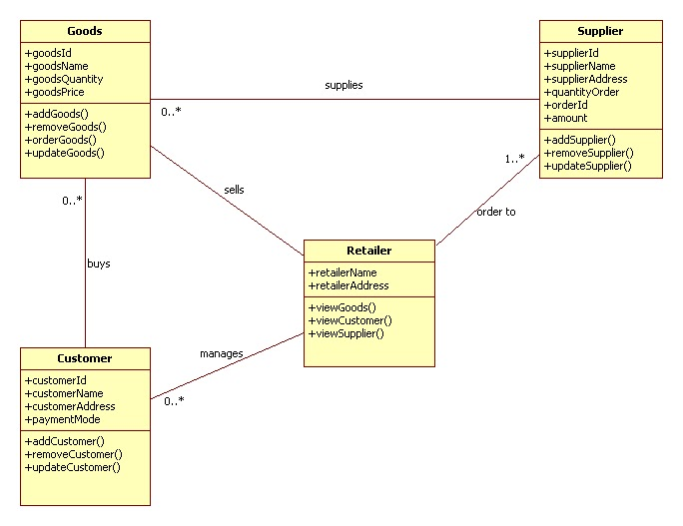
example of object oriented design

Slide 34
d) Implementation
Purpose of implementation phase (aka coding and unit testing phase):
translate software design into source code.
During the implementation phase:
each module of the design is coded,
each module is unit tested
tested independently as a stand alone unit, and debugged,
each module is documented.
The purpose of unit testing:
test if individual modules work correctly.
The end product of implementation phase:
a set of program modules that have been tested individually.

Slide 35
Integration and System Testing
Different modules are integrated in a planned manner:
modules are almost never integrated in one shot.
Normally integration is carried out through a number of steps.
During each integration step,
the partially integrated system is tested.
M1
M2
M3
M4

Slide 36
e) System Testing
After all the modules have been successfully integrated and tested:
system testing is carried out.
Goal of system testing:
ensure that the developed system functions according to its requirements as specified in the SRS document.

Slide 37
f) Maintenance
Maintenance of any software product:
requires much more effort than the effort to develop the product itself.
development effort to maintenance effort is typically 40:60.
Corrective maintenance:
Correct errors which were not discovered during the product development phases.
Perfective maintenance:
Improve implementation of the system
enhance functionalities of the system.
Adaptive maintenance:
Port software to a new environment,
e.g. to a new computer or to a new operating system.

Slide 38
Model-2
Iterative Waterfall Model

Slide 39
Iterative Waterfall Model
Classical waterfall model is idealistic:
assumes that no defect is introduced during any development activity.
in practice:
defects do get introduced in almost every phase of the life cycle.
Defects usually get detected much later in the life cycle:
For example, a design defect might go unnoticed till the coding or testing phase.
Once a defect is detected:
we need to go back to the phase where it was introduced
redo some of the work done during that and all subsequent phases.
Therefore we need feedback paths in the classical waterfall model.

Slide 40
Iterative Waterfall Model (CONT.)
Feasibility Study
Req Analysis
Design
Code
Test
Maintenance

Slide 41
Iterative Waterfall Model
Errors should be detected
in the same phase in which they are introduced.
For example:
if a design problem is detected in the design phase itself,
the problem can be taken care of much more easily
than say if it is identified at the end of the integration and system testing phase.

Slide 42
Phase containment of errors
Reason: rework must be carried out not only to the design but also to code and test phases.
The principle of detecting errors as close to its point of introduction as possible:
is known as phase containment of errors.
Iterative waterfall model is by far the most widely used model.
Almost every other model is derived from the waterfall model.
Irrespective of the life cycle model actually followed:
the documents should reflect a classical waterfall model of development,
comprehension of the documents is facilitated.

Slide 43
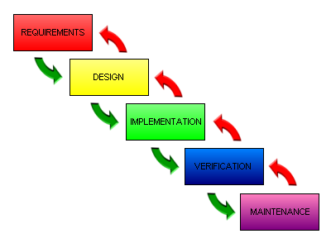
Iterative Waterfall Model

Slide 44
Model-3
Prototyping Model

Slide 45
Prototyping Model
Before starting actual development,
a working prototype of the system should first be built.
A prototype is a toy implementation of a system:
limited functional capabilities,
low reliability,
inefficient performance.

Slide 46
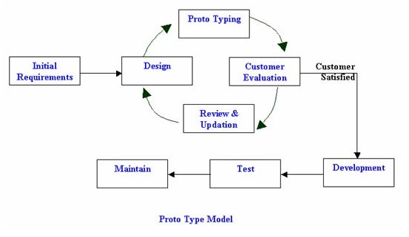
prototype model

Slide 47
Reasons for developing a prototype
1) Illustrate to the customer:
input data formats, messages, reports, or interactive dialogs.
2) Examine technical issues associated with product development:
Often major design decisions depend on issues like:
response time of a hardware controller,
efficiency of a sorting algorithm, etc.

Slide 48
Prototyping Model (CONT.)
3)The third reason for developing a prototype is:
it is impossible to ``get it right'' the first time,
we must plan to throw away the first product
if we want to develop a good product.
Start with approximate requirements.
Carry out a quick design.
Prototype model is built using several short-cuts:
Short-cuts might involve using inefficient, inaccurate, or dummy functions.
A function may use a table look-up rather than performing the actual computations.

Slide 49
Prototyping Model (CONT.)
The developed prototype is submitted to the customer for his evaluation:
Based on the user feedback, requirements are refined.
This cycle continues until the user approves the prototype.
The actual system is developed using the classical waterfall approach.

Slide 50
Prototyping Model (CONT.)
Requirements analysis and specification phase becomes redundant:
final working prototype (with all user feedbacks incorporated) serves as an animated requirements specification.
Design and code for the prototype is usually thrown away:
However, the experience gathered from developing the prototype helps a great deal while developing the actual product.

Slide 51
Prototyping Model (CONT.)
Even though construction of a working prototype model involves additional cost --- overall development cost might be lower for:
systems with unclear user requirements,
systems with unresolved technical issues.
Many user requirements get properly defined and technical issues get resolved:
these would have appeared later as change requests and resulted in incurring massive redesign costs.

Slide 52
Evolutionary Model
Model-4

Slide 53
Advantages of Evolutionary Model
Users get a chance to experiment with a partially developed system:
much before the full working version is released,
Helps finding exact user requirements:
much before fully working system is developed.
Core modules get tested thoroughly:
reduces chances of errors in final product.

Slide 54
Evolutionary Model
Evolutionary model (aka successive versions or incremental model):
The system is broken down into several modules which can be incrementally implemented and delivered.
First develop the core modules of the system.
The initial product skeleton is refined into increasing levels of capability:
by adding new functionalities in successive versions.
Successive version of the product:
functioning systems capable of performing some useful work.
A new release may include new functionality:
also existing functionality in the current release might have been enhanced.

Slide 55
Evolutionary Model (CONT.)
C
A
A
A
B
B

Slide 56
Disadvantages of Evolutionary Model
Often, difficult to subdivide problems into functional units:
which can be incrementally implemented and delivered.
evolutionary model is useful for very large problems,
where it is easier to find modules for incremental implementation.

Slide 57
Evolutionary Model with Iteration
Many organizations use a combination of iterative and incremental development:
a new release may include new functionality
existing functionality from the current release may also have been modified.
Several advantages:
Training can start on an earlier release
customer feedback taken into account
Markets can be created:
for functionality that has never been offered.
Frequent releases allow developers to fix unanticipated problems quickly.

Slide 58
Spiral Model
Model-5

Slide 59
Spiral Model (CONT.)

Slide 60
Spiral Model
Each loop of the spiral represents a phase of the software process:
the innermost loop might be concerned with system feasibility,
the next loop with system requirements definition,
the next one with system design, and so on.
The exact number of loops in the spiral is not fixed.

Slide 61
Spiral Model (CONT.)
The team must decide:
how to structure the project into phases.
Start work using some generic model:
add extra phases
for specific projects or when problems are identified during a project.
Each loop in the spiral is split into four sectors (quadrants).

Slide 62
Objective Setting (First Quadrant)
Identify objectives of the phase,
Examine the risks associated with these objectives.
Risk:
any adverse circumstance that might hamper successful completion of a software project.
Find alternate solutions possible.

Slide 63
Risk Assessment and Reduction (Second Quadrant)
For each identified project risk,
a detailed analysis is carried out.
Steps are taken to reduce the risk.
For example, if there is a risk that the requirements are inappropriate:
a prototype system may be developed.

Slide 64
Spiral Model (CONT.)
Development and Validation (Third quadrant):
develop and validate the next level of the product.
Review and Planning (Fourth quadrant):
review the results achieved so far with the customer and plan the next iteration around the spiral.
With each iteration around the spiral:
progressively more complete version of the software gets built.

Slide 65
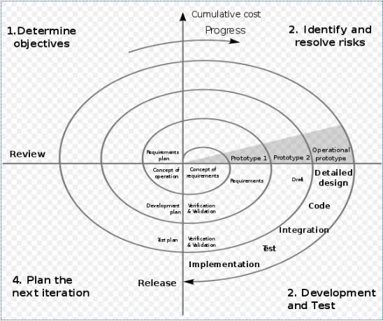

Slide 66
Spiral Model as a meta model
Subsumes all discussed models:
a single loop spiral represents waterfall model.
uses an evolutionary approach --
iterations through the spiral are evolutionary levels.
enables understanding and reacting to risks during each iteration along the spiral.
uses:
prototyping as a risk reduction mechanism
retains the step-wise approach of the waterfall model.

Slide 67
Advantages of Spiral Model
High amount of risk analysis hence, avoidance of Risk is enhanced.
Good for large and mission-critical projects.
Strong approval and documentation control.
Additional Functionality can be added at a later date.
Software is produced early in the software life cycle.
Disadvantages
Can be a costly model to use.
Risk analysis requires highly specific expertise.
Project’s success is highly dependent on the risk analysis phase.
Doesn’t work well for smaller projects.

Slide 68
Circumstances to use spiral model
The spiral model is called a meta model since it encompasses all other life cycle models.
Risk handling is inherently built into this model.
The spiral model is suitable for development of technically challenging software products that are prone to several kinds of risks.
However, this model is much more complex than the other models – this is probably a factor deterring its use in ordinary projects.

Slide 69
Comparison of Different Life Cycle Models
Iterative waterfall model
most widely used model.
But, suitable only for well-understood problems.
Prototype model is suitable for projects not well understood:
user requirements
technical aspects

Slide 70
Comparison of Different Life Cycle Models (CONT.)
Evolutionary model is suitable for large problems:
can be decomposed into a set of modules that can be incrementally implemented,
incremental delivery of the system is acceptable to the customer.
The spiral model:
suitable for development of technically challenging software products that are subject to several kinds of risks.

Slide 71
Rapid Application Development Model
Model-5

Slide 72
RAD
RAD model is Rapid Application Development model.
It is a type of incremental model.
In RAD model the components or functions are developed in parallel as if they were mini projects.
The developments are time boxed, delivered and then assembled into a working prototype.
This can quickly give the customer something to see and use and to provide feedback regarding the delivery and their requirements.

Slide 73
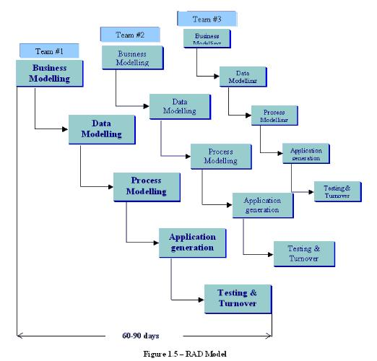

Slide 74
The phases in the rapid application development (RAD) model are:
Business Modeling: In this phase of development business model should be designed based on the information available from different business activities.
Before starting the development there should be a complete picture of business process functionality.
Data Modeling: Once the business modeling phase over and all the business analysis completed, all the required and necessary data based on business analysis are identified in data modeling phase.
Process Modeling: All the data identified in data modeling phase are planned to process or implement the identified data to achieve the business functionality flow. In this phase all the data modification process is defined.

Slide 75
RAD (Cond..)
Application Modeling: In this phase application id developed and coding completed. With help of automation tools all data implemented and processed to work as real time.
Testing and turnover: All the testing activates are performed to test the developed application.

Slide 76
Advantages of RAD Model:
Fast application development and delivery.
Least testing activity required.
Visualization of progress.
Less resources required.
Review by the client from the very beginning of development so very less chance to miss the requirements.
Very flexible if any changes required.
Cost effective.
Good for small projects.

Slide 77
Disadvantages of RAD Model:
High skilled resources required.
On each development phase client’s feedback required.
Automated code generation is very costly.
Difficult to manage.
Not a good process for long term and big projects.
Proper modularization of project required.

Slide 78
V shaped Model
Model-6

Slide 79
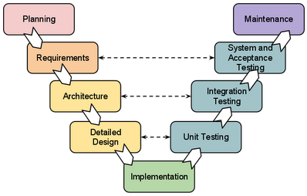
V-Shaped Model
It is an extension for waterfall model, Instead of moving down in a linear way, the process steps are bent upwards after the coding phase, to form the typical V shape.
The major difference between v-shaped model and waterfall model is the early test planning in v-shaped model.

Slide 80
The usage
Software requirements clearly defined and known
Software development technologies and tools is well-known
Advantages
Simple and easy to use.
Each phase has specific deliverables.
Higher chance of success over the waterfall model due to the development of test plans early on during the life cycle.
Works well for where requirements are easily understood.
Verification and validation of the product in early stages of product development

Slide 81
Disadvantages
Very inflexible, like the waterfall model.
Little flexibility and adjusting scope is difficult and expensive.
Software is developed during the implementation phase, so no early prototypes of the software are produced.
Model doesn’t provide a clear path for problems found during testing phases.
Costly and required more time, in addition to detailed plan

Slide 82
Agile Model
Model-7

Slide 83
Agile Model
Combination of iterative and incremental process models with focus on process adaptability and customer satisfaction by rapid delivery of working software product.
Agile Methods break the product into small incremental builds.
These builds are provided in iterations. Each iteration typically lasts from about one to three weeks.
Every iteration involves cross functional teams working simultaneously on various areas like planning, requirements analysis, design, coding, unit testing, and acceptance testing.
At the end of the iteration a working product is displayed to the customer and important stakeholders.

Slide 84
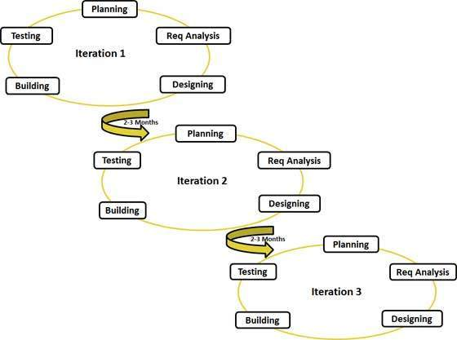

Slide 85
Advantages
Is a very realistic approach to software development
Promotes teamwork and cross training.
Functionality can be developed rapidly and demonstrated.
Resource requirements are minimum.
Delivers early partial working solutions.
Good model for environments that change steadily.
Minimal rules, documentation easily employed.
Enables concurrent development and delivery within an overall planned context.

Slide 86
Disadvantages
Not suitable for handling complex dependencies.
An overall plan, an agile leader and agile PM practice is a must without which it will not work.
Strict delivery management dictates the scope, functionality to be delivered, and adjustments to meet the deadlines.
Depends heavily on customer interaction, so if customer is not clear, team can be driven in the wrong direction.
There is very high individual dependency, since there is minimum documentation generated.
Transfer of technology to new team members may be quite challenging due to lack of documentation.

Slide 87
Comparison of Different Life Cycle Models
Iterative waterfall model
most widely used model.
But, suitable only for well-understood problems.
Prototype model is suitable for projects not well understood:
user requirements
technical aspects

Slide 88
Comparison of Different Life Cycle Models (CONT.)
Evolutionary model is suitable for large problems:
can be decomposed into a set of modules that can be incrementally implemented,
incremental delivery of the system is acceptable to the customer.
The spiral model:
suitable for development of technically challenging software products that are subject to several kinds of risks.

Slide 89
Identify the definite stages through which a software product undergoes during its lifetime.
Explain the problems that might be faced by an organization if it does not follow any software life cycle model.
Identify two basic roles of a system analyst.
Differentiate between structured analysis and structured design.
Identify at least three activities undertaken in an object-oriented software design approach.

Slide 90
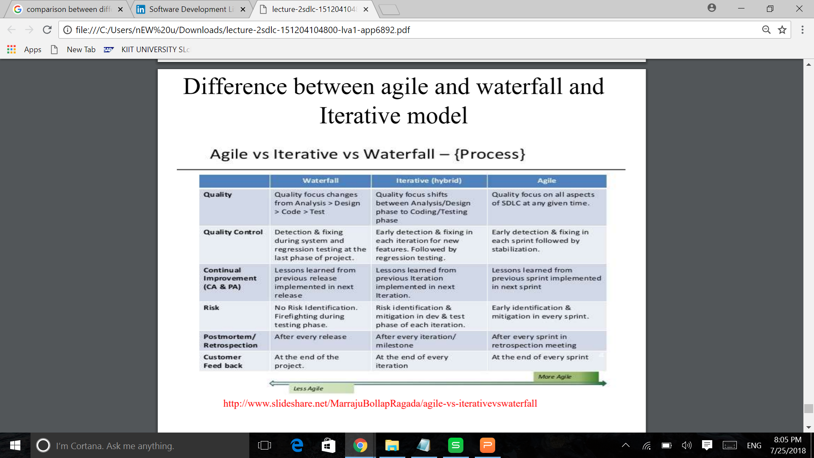

Slide 91
we learned
Classic Waterfall model
Iterative Waterfall model
Protype model
Evolutionary model
Spiral model
Rapid Application Development model
V-shaped model
Agile model

Slide 92
